Slide 1
Newton Playground Committee
Public Consultation Questionnaire Results
Sept 2016

Slide 2
Background
Committee formed to explore the options and appetite for either;
Regenerating and upgrading existing play facilities on Wellington Avenue
Identifying a new site or sites for play equipment elsewhere in the village
Committee to gauge level of support for an application for grant funding and explore possible funding options
Contracted the support of an Independent Playground Designer who conducted a site visit and recommended that an “adventure walk” be created where multiple sites throughout the village could have play features installed in a way that blends with the landscape but encourages exploration and free play
Decision taken to consult with Newton residents by way of a survey, drafted and approved by the committee and posted by hand through the letter box of every property in the village
Responses have been analysed and are presented here for consideration by the Parish Council

Slide 3
Response Rates
Of 333 surveys posted the response
was as follows:
333 surveys hand-delivered to all addresses
240 surveys not returned
95 complete or partially complete surveys submitted (2 with covering letters)
2 letters no survey
Response Rate: 29%*
*Survey specialists, Survey Gizmo, state that a good response rate for a targeted (closed group, medium to high level of personal interest) survey is 30-40% . In contrast a non-targeted survey can only expect a 15% return rate. As such, this response rate can be considered to be within normal parameters for a survey of its type.

Slide 4
Responses by postcode
Responses have been mostly consistent across the older and newer parts of the village
H = old, Z = new:
In total, 20% are not in favour while 80% are supportive

Slide 5
Existing play facilities
Respondents were asked what they thought of the existing play facilities available within the village. Bellow is a summary of these responses from those that chose to answer these questions;
70 have children or grandchildren
Number of individual children in total was 127
24 families use the existing equipment
Number of families not using it is 44
Of those 44 families 40 said they’d use improved equipment

Slide 6
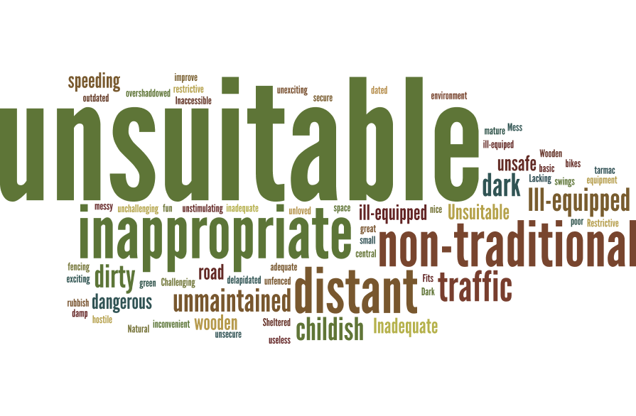
Feedback on Wellington Avenue play area
A word cloud of the phrases used when asked to comment on the current facilities

Slide 7
Preference for improvement activity
Combined Preferences
Old Newton Preference
New Newton Preference

Slide 8
Single site location preference

Slide 9
Importance of features
Which age range respondents felt new facilities should cater for:

Slide 10
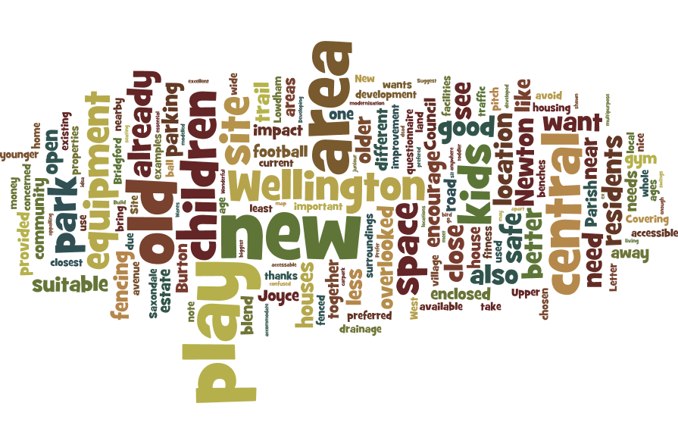
Commentary and feedback
A word cloud of the phrases used when asked to comment on potential facilities (detailed on next page)

Slide 11
Commentary and feedback
Key messages stated were as follows;
Wherever a suggested site was close to a respondent’s property, they were against it’s use
There was a lot of concern about site A’s drainage
There was a strong feeling that site A had the most space and least impact on surrounding houses
There was a strong feeling that site C had the least impact on surrounding houses
There was a repeated desire to see the new site or sites be safe, well fenced in, have signs up advising children at play and not be near to roads
There was a repeated desire for a play-court to enable sports such as football, cricket and basketball for older children
People are concerned about congregating teens and vandalism
There was a repeated desire for natural, wooden equipment that blends well with the grass and woodland surroundings, staying away from garish colours
There was a repeated desire for something that would connect old and new Newton
There was a repeated desire for fitness-related equipment as part of the play trail
The Lowdham, Burton Joyce and West Bridgford parks were referred to as great examples
There was a repeated desire for there to be no improvement of Wellington Avenue, but an equal desire for it to be upgraded
There were a number of comments about spending money on a community centre rather than play facilities
A number of respondents wanted to pass on their appreciation for the efforts of the Playground Committee and Parish Council

