Slide 1
Newton Parish Council
Proposed Community Centre – Questionnaire Results

Slide 2
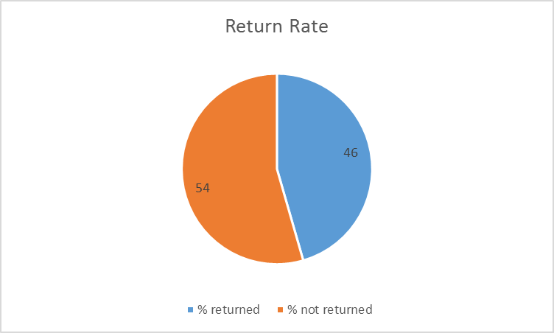

Slide 3
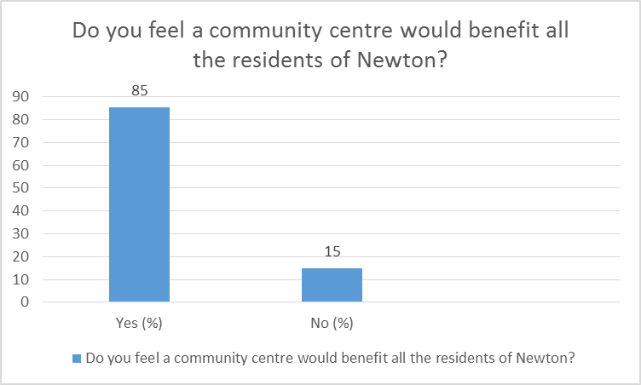

Slide 4
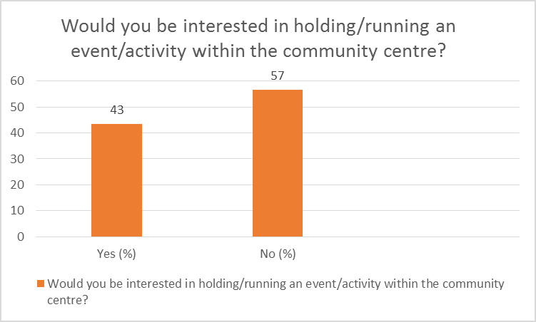

Slide 5
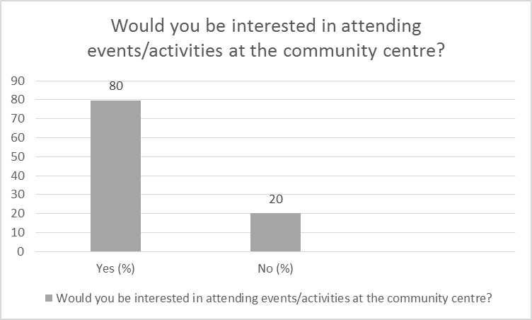

Slide 6
